Slide 1
Course Introduction and Terminology
Pablo E. Gutiérrez-Fonseca, PhD
University of Vermont
Fall 2024

Slide 2
Outline
Course introduction
Terminology

Slide 3
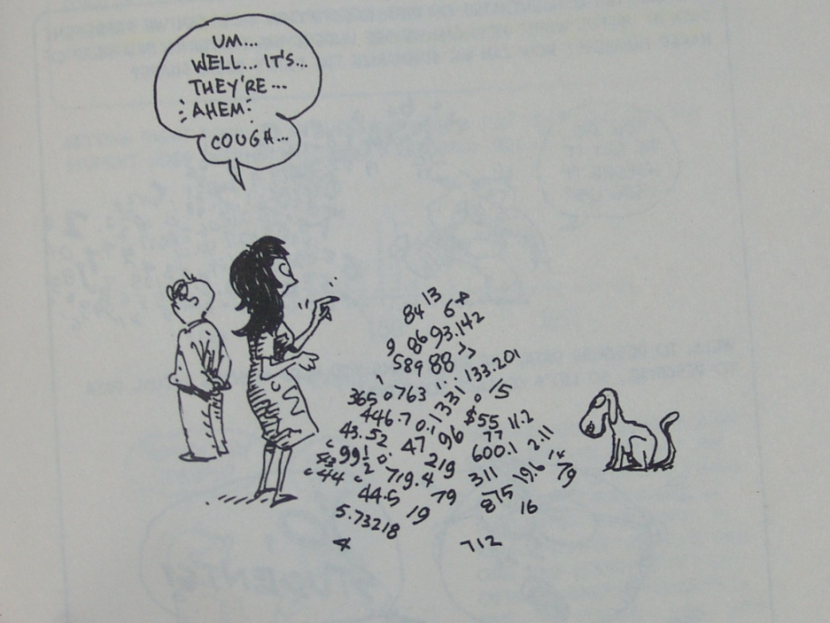
Statistics: What it is?
Statistics describes “a set of tools and techniques that are used for describing, organizing, and interpreting data.”
Without the use of statistics,
we muddle through life making
choices based on incomplete
information.

Slide 4
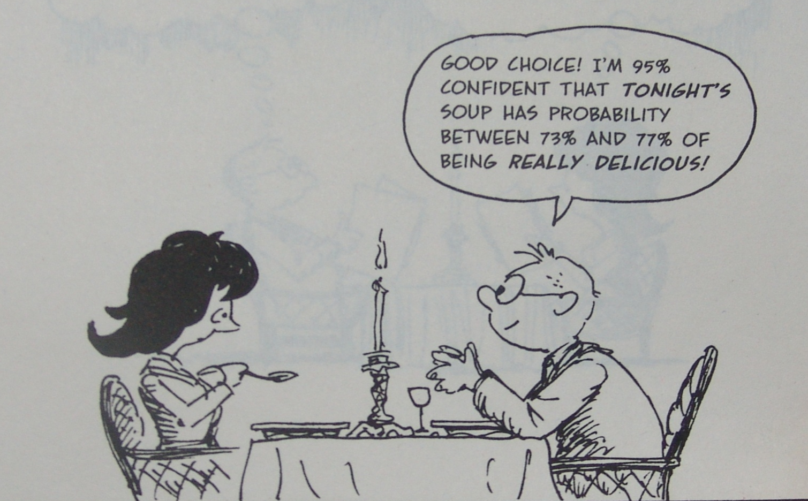
What does Statistics give us?
How does the process of statistical analysis allow us to learn from the world around us?
Transforming uncertainty into Wisdom.
What makes statistics unique is its ability to quantify uncertainty.

Slide 5
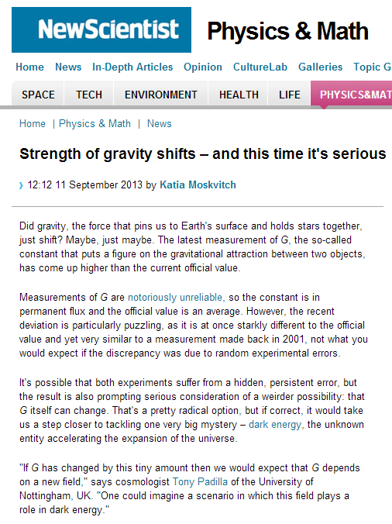
Transforming uncertainty into wisdom
Nothing can be PROVEN with 100% certainty.
No matter how strongly a theory is supported by empirical evidence, it is always theoretically conceivable that one day, some data will come in that will force the scientists to modify or even eliminate the theory.
Notes:
No matter how strongly a theory is supported by empirical evidence, it is always theoretically conceivable that one day, some data will come in that will force the scientists to modify or even eliminate the theory. Even if the scientists are 99.99 percent sure that the theory is true, it is philosophically incorrect to say that it is 100% true and to call it the Truth with the capital T. That is why scientists, when interviewed in the media, often sound uncertain and wishy-washy, while some quack or pseudoscientist pronounces his absolute certainty. Audience not educated in the scientific method is likely to swallow the pseudoscience bait, hook and sinker because we, as humans, crave certainty. It takes some scientific training to be able to fully embrace and even love uncertainty. That is why it is difficult for scientific knowledge to counteract financially, religiously and politically motivated assaults on it. However, nature does not care about what we like and wish for: the apples will continue to fall down, the continents will continue to move around the globe (causing earthquakes and volcanic eruptions) and the organisms will continue to evolve whether we like it or not, whether we believe in it or not

Slide 6
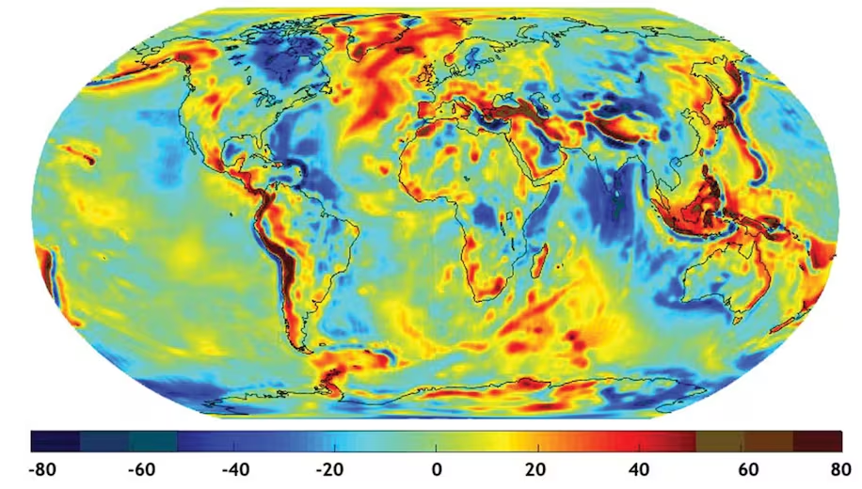
Transforming uncertainty into wisdom
Nothing can be PROVEN with 100% certainty.
Gravity from 9.78 meters per second squared (m/s²)
at the equator to 9.83 m/s² at the poles.
Notes:
No matter how strongly a theory is supported by empirical evidence, it is always theoretically conceivable that one day, some data will come in that will force the scientists to modify or even eliminate the theory. Even if the scientists are 99.99 percent sure that the theory is true, it is philosophically incorrect to say that it is 100% true and to call it the Truth with the capital T. That is why scientists, when interviewed in the media, often sound uncertain and wishy-washy, while some quack or pseudoscientist pronounces his absolute certainty. Audience not educated in the scientific method is likely to swallow the pseudoscience bait, hook and sinker because we, as humans, crave certainty. It takes some scientific training to be able to fully embrace and even love uncertainty. That is why it is difficult for scientific knowledge to counteract financially, religiously and politically motivated assaults on it. However, nature does not care about what we like and wish for: the apples will continue to fall down, the continents will continue to move around the globe (causing earthquakes and volcanic eruptions) and the organisms will continue to evolve whether we like it or not, whether we believe in it or not

Slide 7
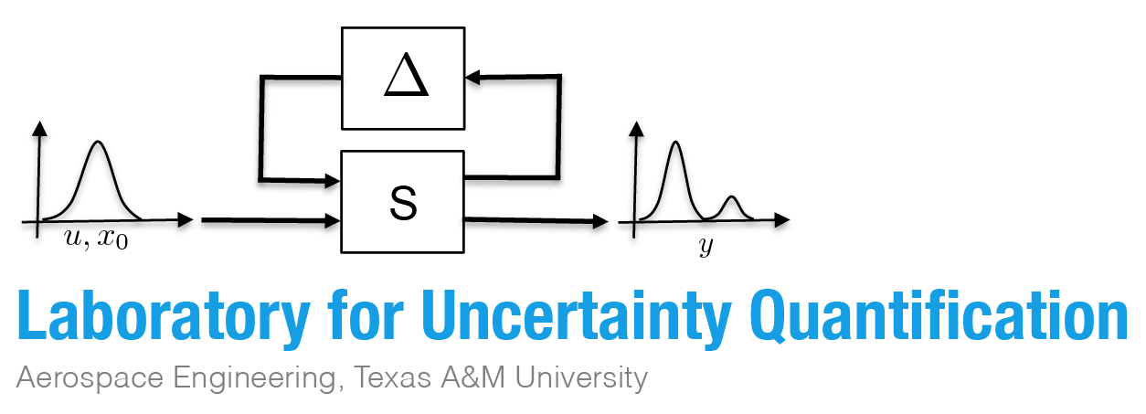
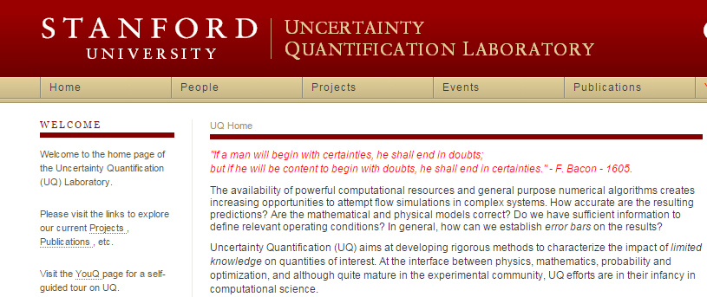
Transforming Uncertainty into wisdom
Our Goal:
Quantify the level of uncertainty and use this to make Informed decisions.
Notes:
No matter how strongly a theory is supported by empirical evidence, it is always theoretically conceivable that one day, some data will come in that will force the scientists to modify or even eliminate the theory. Even if the scientists are 99.99 percent sure that the theory is true, it is philosophically incorrect to say that it is 100% true and to call it the Truth with the capital T. That is why scientists, when interviewed in the media, often sound uncertain and wishy-washy, while some quack or pseudoscientist pronounces his absolute certainty. Audience not educated in the scientific method is likely to swallow the pseudoscience bait, hook and sinker because we, as humans, crave certainty. It takes some scientific training to be able to fully embrace and even love uncertainty. That is why it is difficult for scientific knowledge to counteract financially, religiously and politically motivated assaults on it. However, nature does not care about what we like and wish for: the apples will continue to fall down, the continents will continue to move around the globe (causing earthquakes and volcanic eruptions) and the organisms will continue to evolve whether we like it or not, whether we believe in it or not

Slide 8
Outline
Course Introduction
Terminology

Slide 9
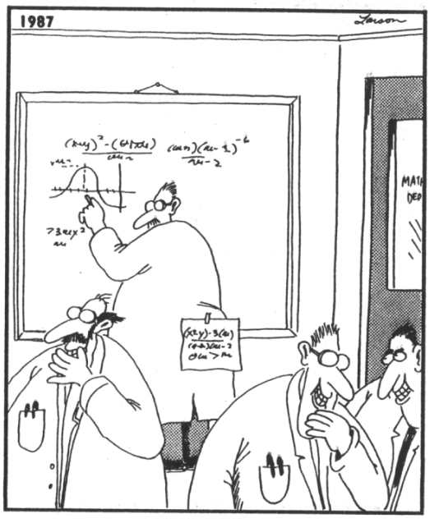
Thinking like a statistician
Becoming Bilingual:
Some key terms you should know and understand so that we can communicate during the rest of the semester.

Slide 10
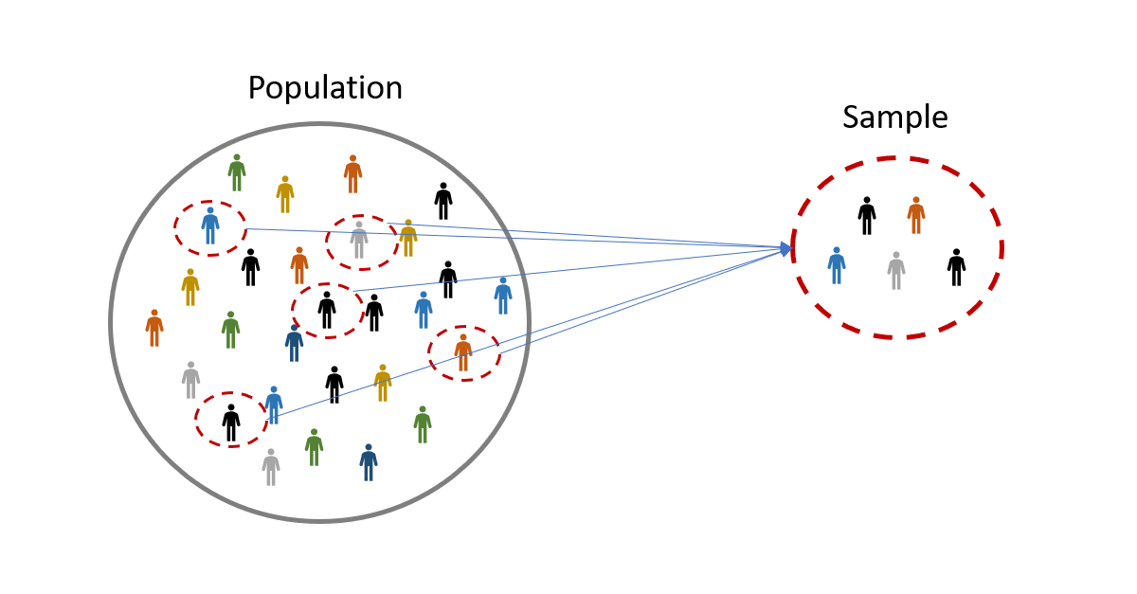
Thinking like a statistician
Population: A population is the collection or aggregate of all elements or items of interest in a particular study about which we wish to make an inference.
Sample: a subset of measurements taken from a population (n).
Random Sample: sample drawn in such a way that all observations have an equal chance of being selected
BUT…….be careful…..your sample should represent the complete range of characteristics you expect in your population
Data is created, not found!
Observation: a recording of some information on a sample unit (X).
Observations are sometimes called samples, measurements, values or just plain “n”
Notes:
"Data is created, not found" means that data doesn't simply exist out there waiting to be discovered; it is generated through the processes we choose, such as how we design experiments, what we decide to measure, and how we collect and interpret that information. Th

Slide 11
Thinking like a statistician
Independence: selection of any one sample unit (observations) does not affect the chances of any other unit being selected.
Variables can also be independent (co-vary in an unrelated pattern).
Replicate: If measurements are in some way related, they must be treated as replicates and “nested” within the analysis such that sample size reflects the number of independent observations.
One simple way to work with replicates is to simply average them for each unit of observation.

Slide 12
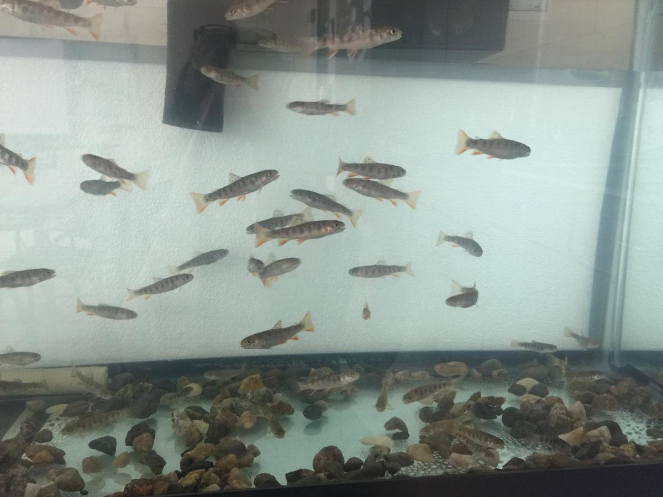
Thinking like a statistician
Each *tank* is a replicate, but within each tank each trout is not independent.
A replicate is "the smallest experimental unit to which a treatment is independently applied.“
Most models for statistical inference require true replication. True replication permits the estimation of variability within a treatment.
Tank #1
Tank #2
Tank #3

Slide 13
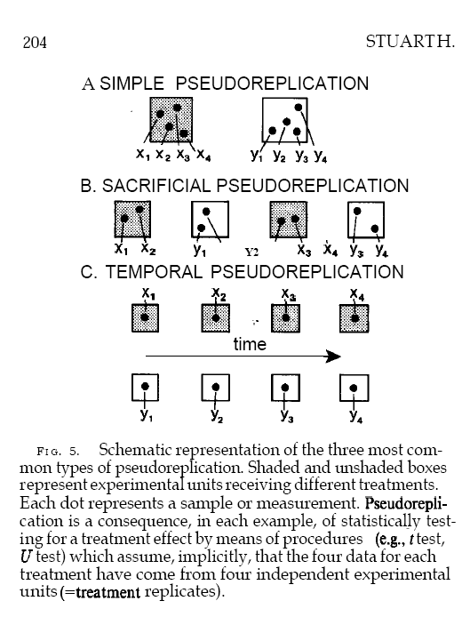
Thinking like a statistician
The simplest and most common type of pseudo-replication occurs when there is only one replicate per treatment.
Sacrificial pseudo-replication occurs when data from true replicates are combined before analysis, removing their independence and potentially leading to inaccurate results.
Temporal pseudo-replication is also common in ecological experiments in which a time series of data are accumulated.
Notes:
Sacrificial pseudoreplication happens when, even though an experiment is properly designed with true replicates, the data from these replicates are combined (or pooled) before measurement or statistical analysis. This pooling eliminates the independence of the replicates, as it treats them as a single data point rather than as separate, independent observations. As a result, the analysis doesn't accurately reflect the variation between replicates, leading to potentially misleading conclusions.

Slide 14
Thinking like a statistician
Variable: a quantity counted or measured the characteristic that is being observed.
Quantitative Variables: a measurable “amount”.
Continuous variable: may assume any imaginable value within a certain range.
… can (theoretically) have an infinite number of values.
Weights, Heights…
Discrete Variables: countable as integers (whole numbers).
No values between two adjacent values are permissible.
Number of bicycles sold in a day.
Continuous
(measuring)
Quantitative
data
Discrete
(counting)

Slide 15
Thinking like a statistician
Variable: a quantity counted or measured the characteristic that is being observed.
Qualitative Variables: descriptive characteristic assignable to a category
Nominal Variables: measurements fall into a particular class or category with no order implied.
sex (male or female)…
Ordinal Variables: a ranking scale where order between categories is implied.
Interval (ratio) Variables: use a quantitative measurement to assign a specific qualitative category (these are still ordinal).
Notes:
Qualitative examples: male or female, survey data (do you agree somewhat, strongly, etc)
Nominal: male or female, tree species,
Ordinal example: greater than or less than, vigor index, agree somewhat, etc
Interval: use velocity to classify into speeding or not speeding, health class based on measurements of dieback etc.

Slide 16
Thinking like a statistician
More ways to describe our variables:
Independent: measurable variables whose value is not dependent upon other measured variables: aka input variables
Dependent: variable you want to predict. The outcome of interest: aka the response variable
We hypothesize that its value is dependent on the value of the other measured variables.

Slide 17
Thinking like a statistician
You will find that there are other terms commonly used to refer to variables:
Independent Variables can be called:
Factor
Treatment
Level
X
Input
Dependent Variables can be called:
Response
Y
Outcome

Slide 18
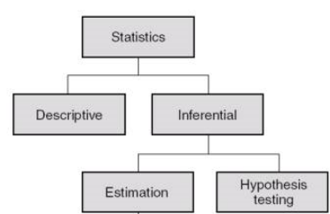
Different Types of Statistics

Slide 19
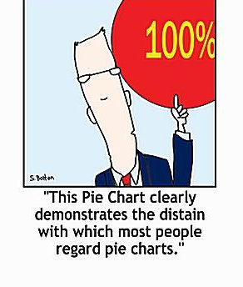
Descriptive statistics
Descriptive statistics are statistics that quantitatively describe or summarize the data.
The aim of descriptive statistics is to summarize a sample, rather than use the data to learn about the population.
Usually, information is displayed visually in tables or figures.

Slide 20
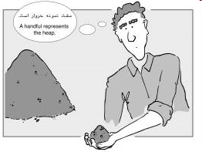
Inferential statistics
Mathematical methods that use probability theory to infer the properties of a population from the analysis of a sample drawn from it.
Inferential statistics aim to make generalizations and predictions from the sample to the population.
Makes assumptions about the entire population based on what you see in your sample.
Example: quantifying the typical stocking levels for forests across Vermont based on FIA inventory data.
Allows us to test hypotheses.

Slide 21
Why inferential statistics?
Large populations make investigating each member impractical and expensive.
Easier and cheaper to take a sample and make estimates about the population from the sample.

Slide 22
Statistics
Statistical Modeling
Used to predict future outcomes based on observed patterns.
Modeling a dependent variable based on one or more independent variables.
Example: Predicting future trends in forest stocking based on historical inventories
Example: Climate effects based on CO2
Can be theoretical (based on established relationships) or Empirical (based on measurements)

Slide 23
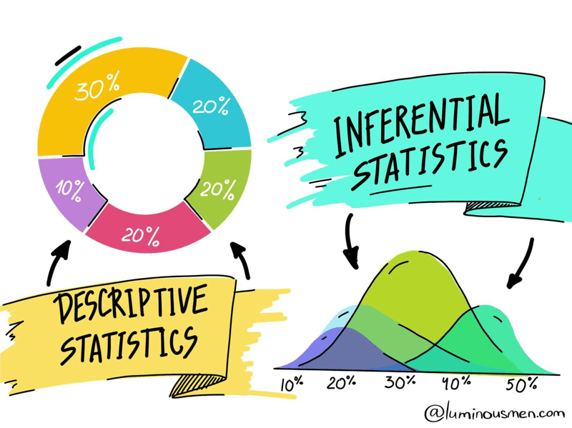
One big happy family
Descriptive and Inferential Statistics: close cousins and both required statistical analyses.
Descriptive Statistics:
We measured the length of each fish in Shelburne Pond and found that the mean length was 15 inches, the standard deviation was 2 inches, the minimum length was 10 inches, and the maximum length was 20 inches.
Inferential Statistics:
We measured the length of each fish in Shelburne Pond and then announced that we are 95% confident that the average length of all fish in the lake is between 14.5 and 15.5 inches.

Slide 24
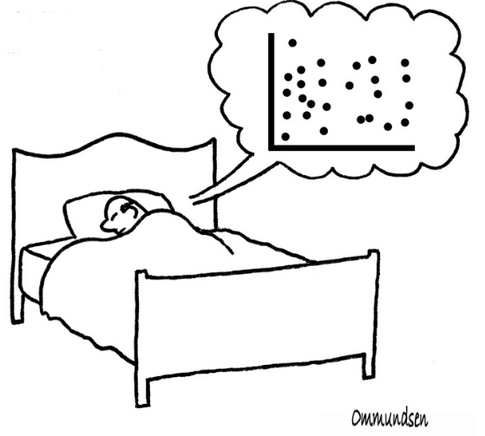
How to know when you are fluent
Think like a statistician

Slide 25
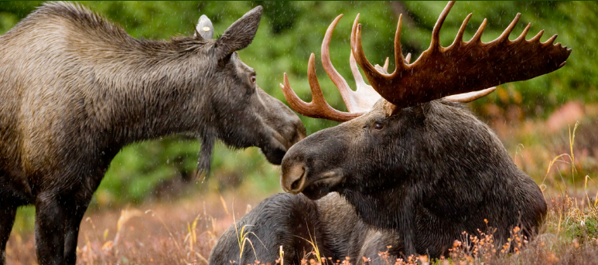
Terminology in Action
Research Question
Population
Sample
Observation
Name and Describe the variables
Analysis Type
Moose herds across the Northeast are increasingly under stress from climate change. Specifically, wildlife biologists are concerned that warmer falls and early springs are increasing winter tick numbers that can have detrimental effects on moose. They have tranquilized and sampled 59 moose from across the state of VT to see if the density (mean per sq. inch from 5 patches) of winter ticks is impacting moose vitality (measured as weight).

Slide 26
Terminology in Action
Research Question
Population
Sample
Observation
Name and Describe the variables
Analysis Type
Is winter tick density related to moose weight?
All moose in VT
The 59 moose they were able to catch
Moose herds across the Northeast are increasingly under stress from climate change. Specifically, wildlife biologists are concerned that warmer falls and early springs are increasing winter tick numbers that can have detrimental effects on moose. They have tranquilized and sampled 59 moose from across the state of VT to see if the density (mean per sq. inch from 5 patches) of winter ticks is impacting moose vitality (measured as weight).
A moose (the 5 patches on each moose are replicates)
Dependent = Moose Weight (continuous)
Independent = Tick density (continuous)
Inferential - Correlation

Slide 27

Terminology in Action
Research Question
Population
Sample
Observation
Name and Describe the variables
Analysis Type
Is there a relationship between cryptocurrencies and deaths due to covid19?
We examine the relationship between cryptocurrencies and COVID-19 cases/deaths. This will help explore whether cryptocurrencies can serve as a hedge against COVID-19. The wavelet coherence analysis indicates that there is initially a negative relationship between Bitcoin and the number of reported cases and deaths; however, the relationship becomes positive during the later period. The findings for Ethereum and Ripple are also similar but with weaker interactions. This supports the hedging role of cryptocurrencies against the uncertainty raised by COVID-19.
Worldwide COVID-19 cases and deaths
Worldwide COVID-19 cases and deaths
Cases and deaths
Dependent: Covid cases and death
Independent: US$ prices of Bitcoin (BTC), Ethereum (ETH), and Ripple (XRP)
Inferential – Correlation
Notes:
https://link.springer.com/article/10.1007/s40822-020-00154-1

Slide 28
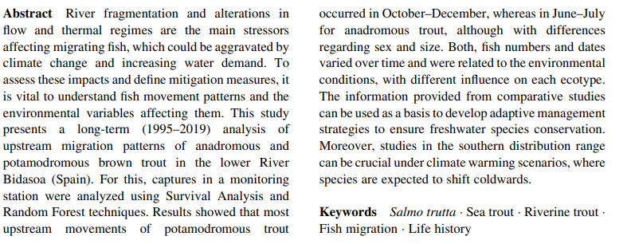
Terminology in Action
Research Question
Population
Sample
Observation
Name and Describe the variables
Analysis Type
Is there a significant trend in trout migration?
All Trout in the lower River Bidasoa
Trout in the lower River Bidasoa (Spain)
Abundance each year
Dependent: Number of fish
Independent: Year (ordinal), Stream Discharge
Inferential – Random forest regression

Slide 29
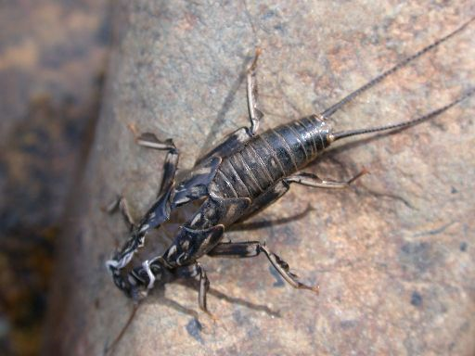
Terminology in Action
Research Question
Population
Sample
Observation
Name and Describe the variables
Analysis Type
Does the density of agriculture and development impact macroinvertebrate species richness?
All streams in VT
12 Sentinel streams in VT
The Vermont DEC is monitoring twelve “sentinel” streams in Vermont. These reference streams are widely variable in terms of development and agricultural density. Scientists are using species richness of sensitive macroinvertebrates at three drift net locations along each stream as an indicator of overall water quality to see if the density of agriculture and development (categorized as minimal, mixed or moderate) within watersheds significantly impairs water quality.
A stream (drift net replicates at each stream)
Dependent: species richness (continuous)
Independent: Ag density (ordinal), Dev density (ordinal)
Inferential: Factorial ANOVA

